Slide 1
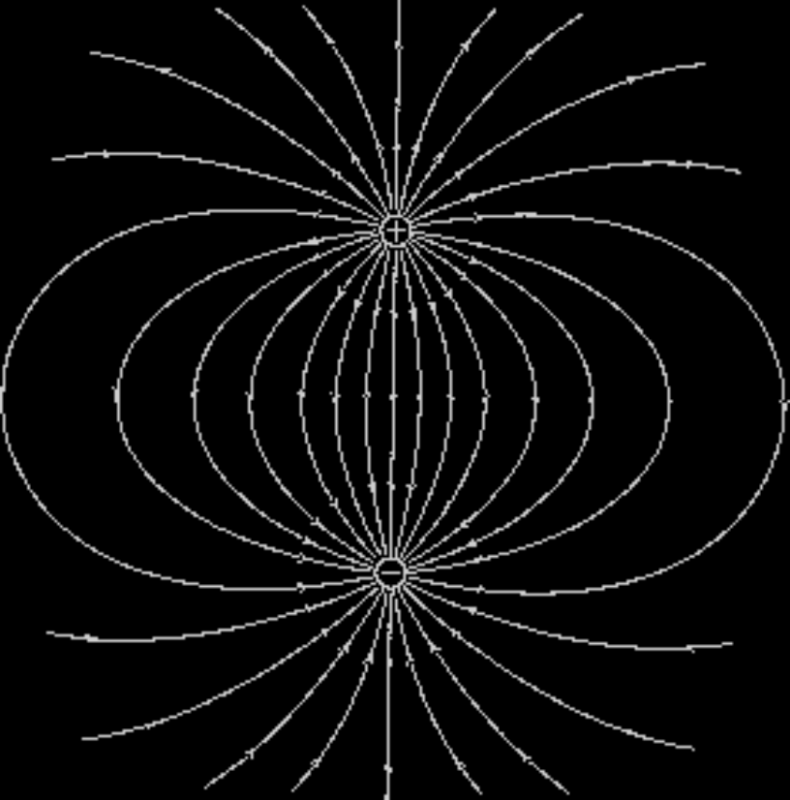
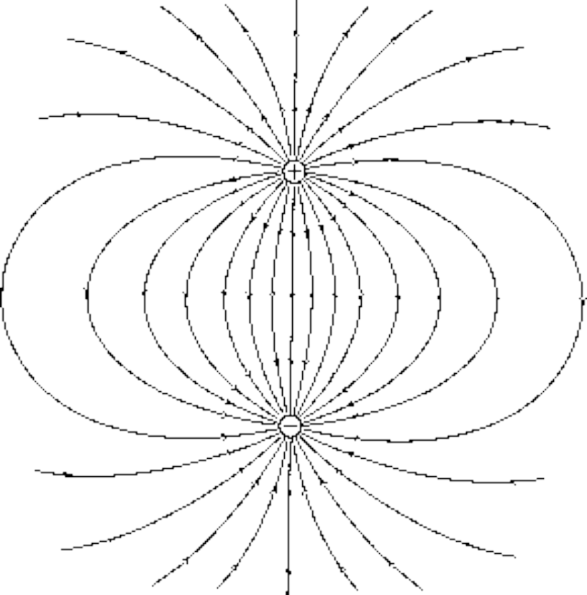

Gauss' Law
c
a
b

Slide 2
27-1 Introduction:
Fundamental Law of Electrostatics(静电学)
Coulomb’s Law: Force between two point charges
Gauss’ Law: Relationship between Electric Fields
and charges
Although Gauss’ law and Coulomb’s law give the identical results.
Gauss’ Law offers a much simpler way to calculate E in situations with a high degree of symmetry (高对称的情况).
Gauss’ Law as the fundamental law of electrostatics.
Gauss’ Law is valid in the case of rapidly moving charges.
Gauss’ Law is more general than Coulomb’s law.

Slide 3
27-2(3) The Flux of a vector field, electric field
Flux (Φ) 流量(通量), 流体的流量
How much of something is passing through some surface
  Ex: How many hairs passing through your scalp.
Two ways to define
  Number per unit area (e.g., 10 hairs/mm²)
    This is NOT what we use here.
  Number passing through an area of interest
    e.g., 48,788 hairs passing through my scalp.
    This is what we are using here.

Slide 4
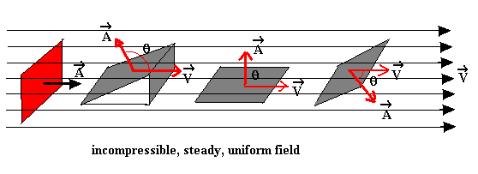
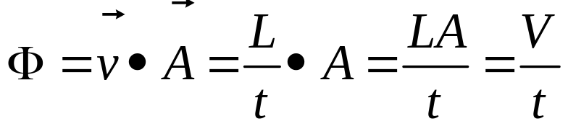
Example: The velocity field (速度场) of the fluid flows
A single loop of area A
Considering a single loop placed in the stream its plane is perpendicular to the direction of flow, the fluid volume passed through this loop per unit time
(单位时间流过该回路的体积).
Define Φ is the Flux of the velocity field.

Slide 5

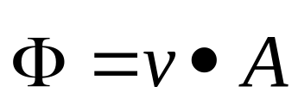
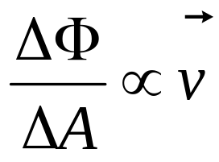
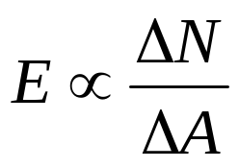
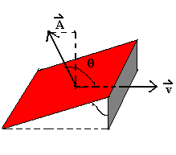
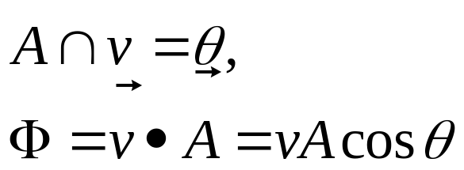
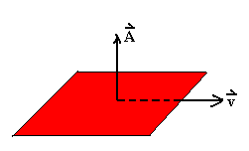
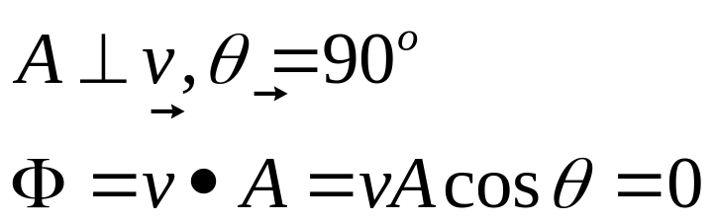
It is convenient to consider it as a measure of the number of field lines passing through the loop.
(b)
(C)

Slide 6
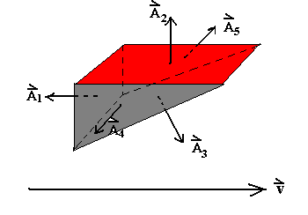
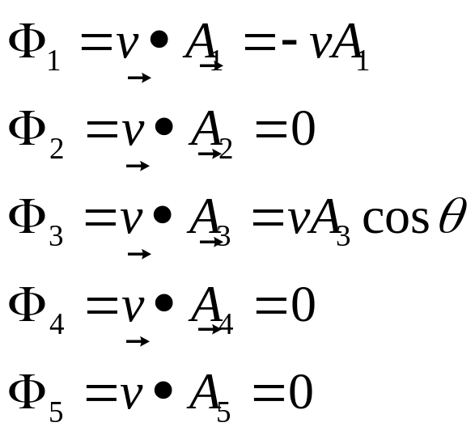
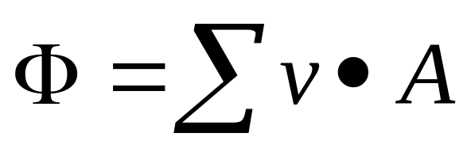
A closed area (闭合曲面)
The net mount of fluid out the volume:

Slide 7
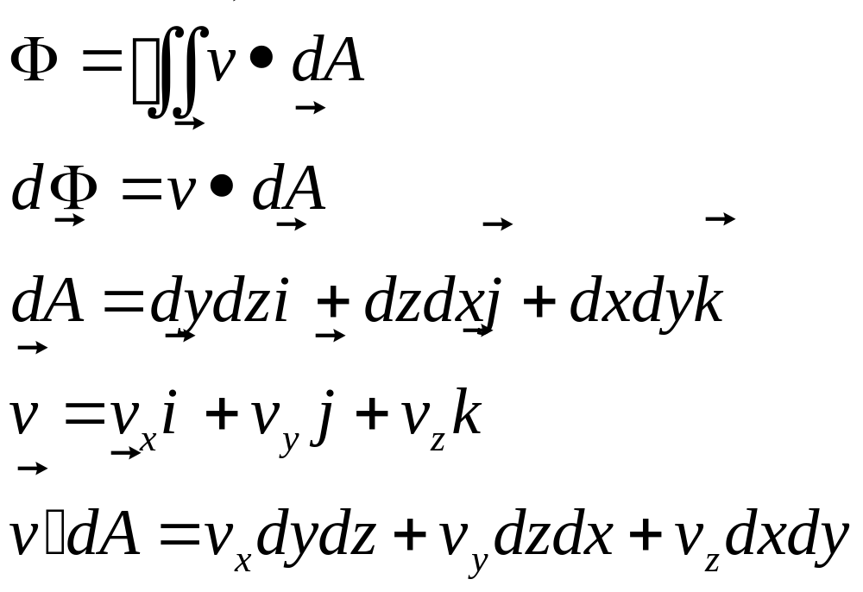
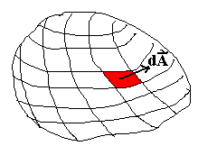
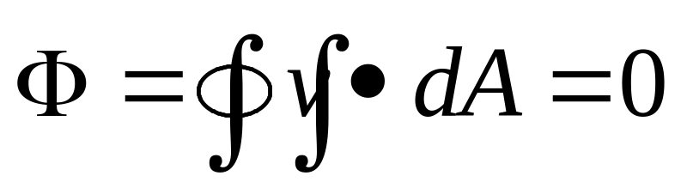
For any closed surface
If there were within the volume no sources or sink of fluid.

Slide 8
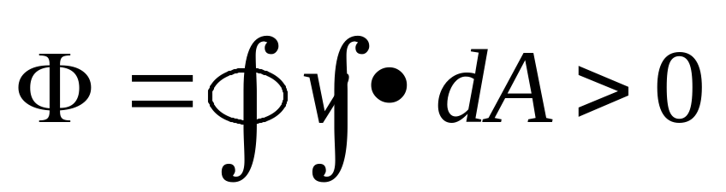
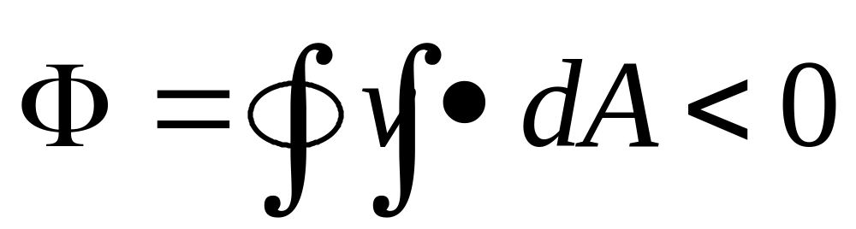
If there were a source (源) within the volume:
If there were a sink of fluid:

Slide 9
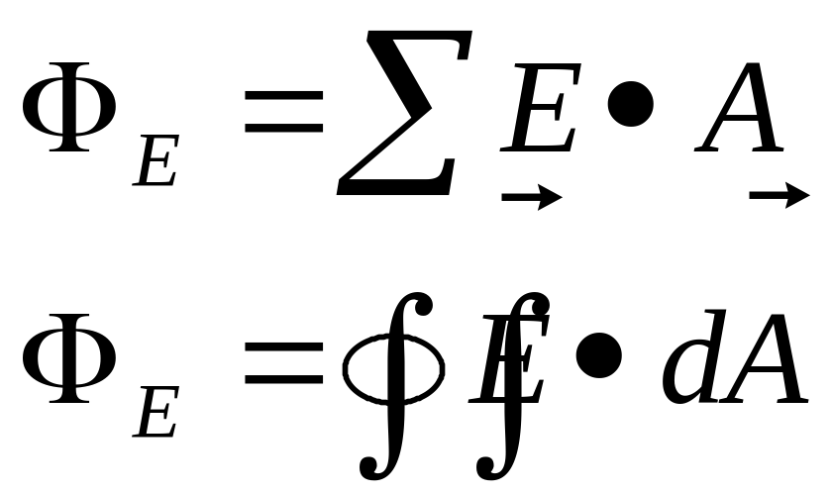
2. The flux of the electric Field (电通量)
  Even although nothing is flowing in the electrostatic case, we still use the concept of field.
  Let’s quantify previous discussion about field-line “counting”
  Define: electric flux Φ_{Ε} through the closed surface A
The number of lines of electric field (电力线数目) passing through the closed surface A.

Slide 10
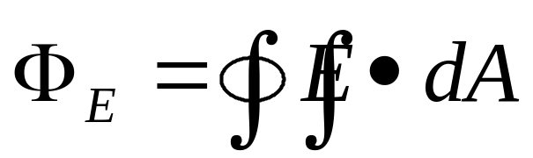


Electric Flux (电通量)
What does this new quantity mean?
  The integral is over a CLOSED SURFACE
  Since is a SCALAR product, the electric flux is a SCALAR quantity
  The integration vector is normal to the surface and points OUT of the surface. is interpreted as the component of E which is NORMAL to the SURFACE
  Therefore, the electric flux through a closed surface is the sum of the normal components (垂直分量) of the electric field all over the
  surface.
  The sign matters!!
  Pay attention to the direction of the normal component as it penetrates the surface… is it “out of” or “into” the surface?
  “Out of” is “+” “into” is “-”

Slide 11
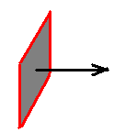
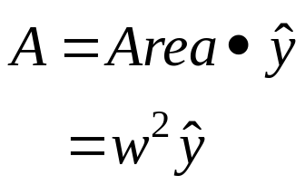



How to think about flux
We will be interested in net flux in or out of a closed surface like this box
This is the sum of the flux through each side of the box
  consider each side separately
Let E-field point in y-direction
  then and are parallel and
Look at this from on top
  down the z-axis
w
z
“A” is surface
of the box
y
x

Slide 12
How to think about flux
Consider flux through two surfaces that “intercept different numbers of field lines”
  first surface is side of box from previous slide
  Second surface rotated by an angle θ
case 1
Flux:
case 2
E-field surface area E A
case 1
Case 2 is
smaller!
θ
case 2

Slide 13

The Sign Problem
For an open surface we can choose the direction of A-vector two different ways
  to the left or to the right
  what we call flux would be different these two ways
  different by a minus sign
left
right
For a closed surface we can choose the direction of A-vector two different ways
  pointing “in” or “out”
  define “out” to be correct
  Integral of EdA over a closed surface gives net flux “out,” but can be + or -
A differential surface
element, with its vector

Slide 14
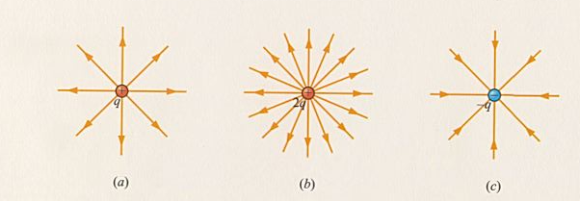
Chapter 27, ACT 1
3A
Imagine a cube of side a positioned in a region of constant electric field as shown
  Which of the following statements about the net electric flux Φ_{E} through the surface of this cube is true?
a
a
(a) Φ_{E} = 0
(b) Φ_{E} ∝ 2a²
(c) Φ_{E} ∝ 6a²
3B
Consider 2 spheres (of radius R and 2R) drawn around a single charge as shown.
  Which of the following statements about the net electric flux through the 2 surfaces (Φ_{2R} and Φ_{R}) is true?
R
2R
(a) Φ_{R} < Φ_{2R}
(b) Φ_{R} = Φ_{2R}
(c) Φ_{R} > Φ_{2R}

Slide 15
Chapter 27, ACT 1
3A
Imagine a cube of side a positioned in a region of constant electric field as shown
  Which of the following statements about the net electric flux Φ_{E} through the surface of this cube is true?
a
a
(a) Φ_{E} = 0
(b) Φ_{E} ∝ 2a²
(c) Φ_{E} ∝ 6a²

Slide 16
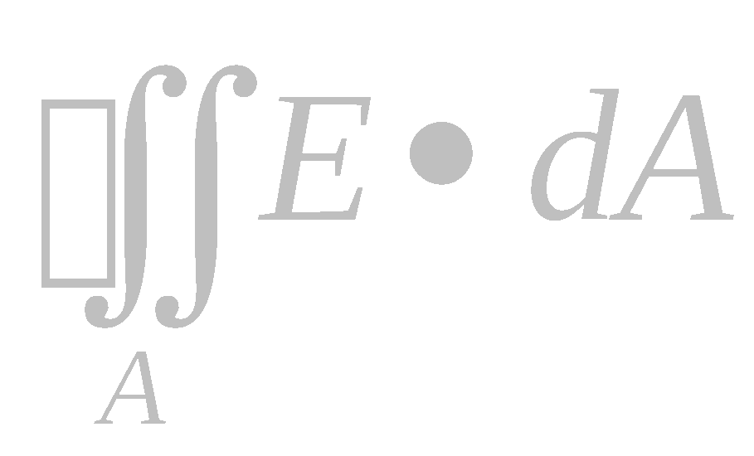
Chapter 27, ACT 1
Consider 2 spheres (of radius R and 2R) drawn around a single charge as shown.
  Which of the following statements about the net electric flux through the 2 surfaces (Φ_{2R} and Φ_{R}) is true?
3B
R
(a) Φ_{R} < Φ_{2R}
(b) Φ_{R} = Φ_{2R}
(c) Φ_{R} > Φ_{2R}
2R
Look at the lines going out through each circle -- each circle has the same number of lines.
The electric field is different at the two surfaces, because E is proportional to 1 / r ², but the surface areas are also different. The surface area of a sphere is proportional to r ².
Since flux = , the r ² and 1/r ² terms will cancel, and the two circles have the same flux!
There is an easier way. Gauss’ Law states the net flux is proportional to the NET enclosed charge. The NET charge is the SAME in both cases.

Slide 17
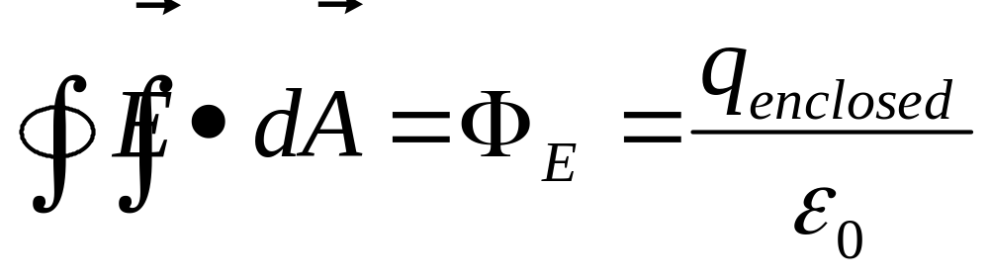
27-4 Gauss’ Law
Gauss’ Law (a FUNDAMENTAL LAW):
  The net electric flux through any closed surface is proportional to the charge enclosed by that surface.
How do we use this equation??
  The above equation is ALWAYS TRUE but it doesn’t look easy to use.
  It is very useful in finding E when the physical situation exhibits massive SYMMETRY.

Slide 18
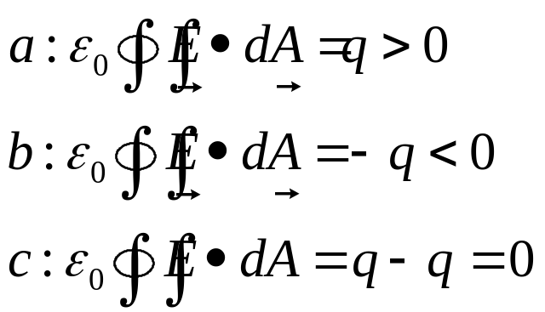
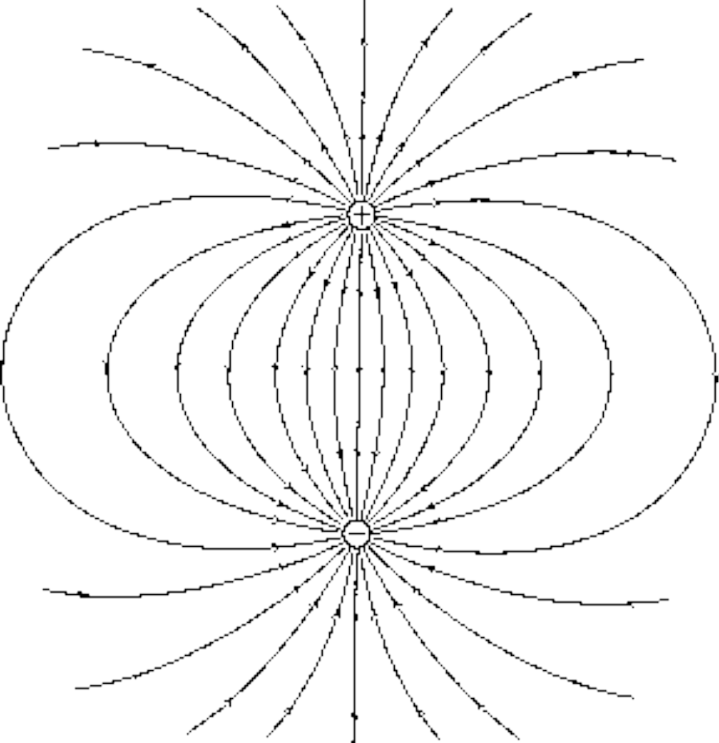
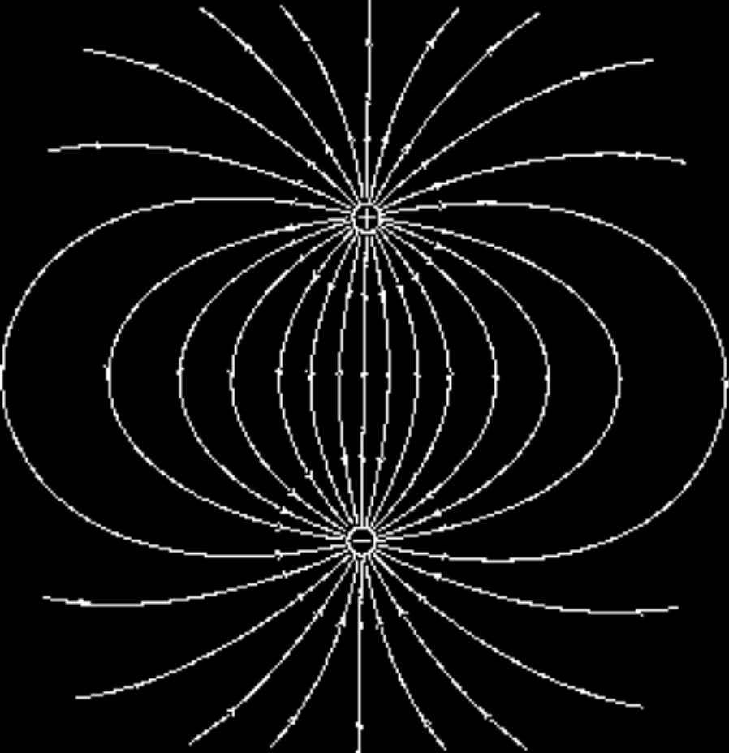
Example: a dipole (电偶极矩)
c
a
b

Slide 19
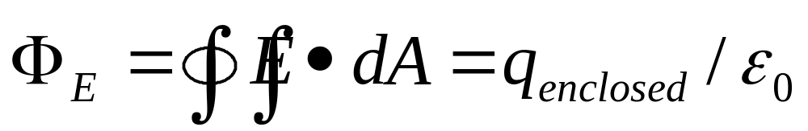
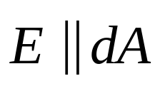
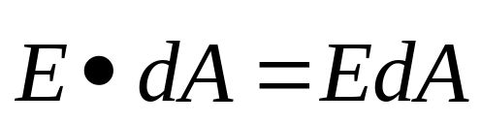



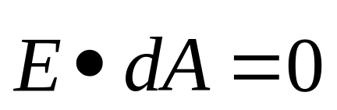


Gauss’ Law…made easy
  To solve the above equation for E, you have to be able to CHOOSE A CLOSED SURFACE such that the integral is TRIVIAL.
    (1) Direction: surface must be chosen such that E is known to be either parallel or perpendicular to each piece of the surface;
    If then
    If then
    (2) Magnitude: surface must be chosen such that E has the same value at all points on the surface when E is perpendicular to the surface.

Slide 20
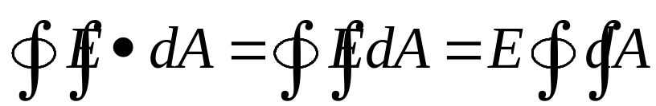

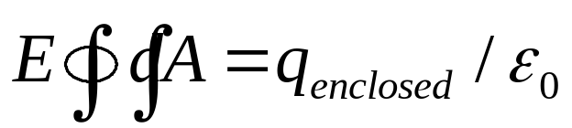
Gauss’ Law…made easy
    With these two conditions we can bring E outside of the integral…and:
    Note that is just the area of the Gaussian surface over which we are integrating. Gauss’ Law now takes the form:
    This equation can now be solved for E (at the surface) if we know q_{enclosed} (or for q_{enclosed} if we know E).

Slide 21

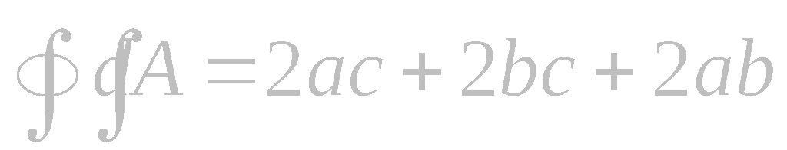
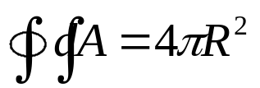
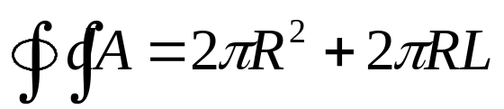
Geometry and Surface Integrals
If E is constant over a surface, and normal to it everywhere, we can take E outside the integral, leaving only a surface area
you may use different E’A
for different surfaces
of your “object”
z
c
y
b
a
x
z
R
R
L

Slide 22

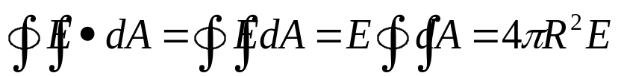
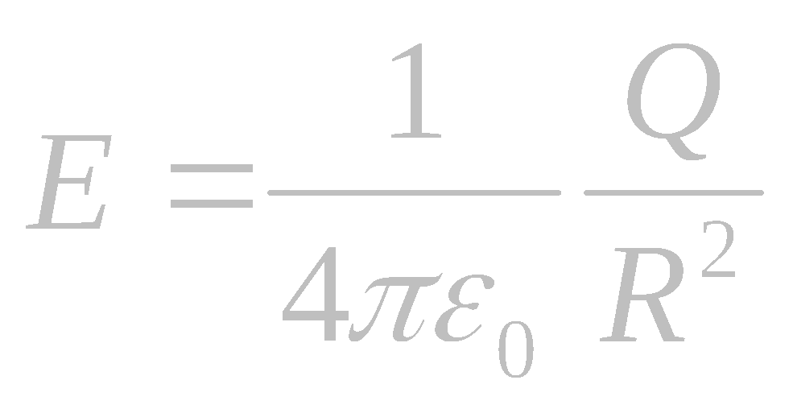
Gauss Law ⇒ Coulomb Law
We now illustrate this for the field of the point charge and prove that Gauss’ Law implies Coulomb’s Law.
Symmetry ⇒ E-field of point charge is radial and spherically symmetric
Draw a sphere of radius R centered on the charge.
E
R
+Q
Why?
  E normal to every point on the surface
  E has same value at every point on the surface
  can take E outside of the integral!
Therefore, !
  Gauss’ Law
  We are free to choose the surface in such problems… we call this a “Gaussian” surface
⇒
⇒

Slide 23
27-5, 6 Applications of Gauss’ Law

Slide 24

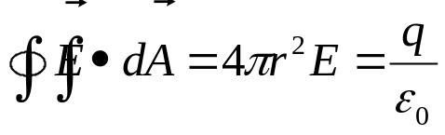
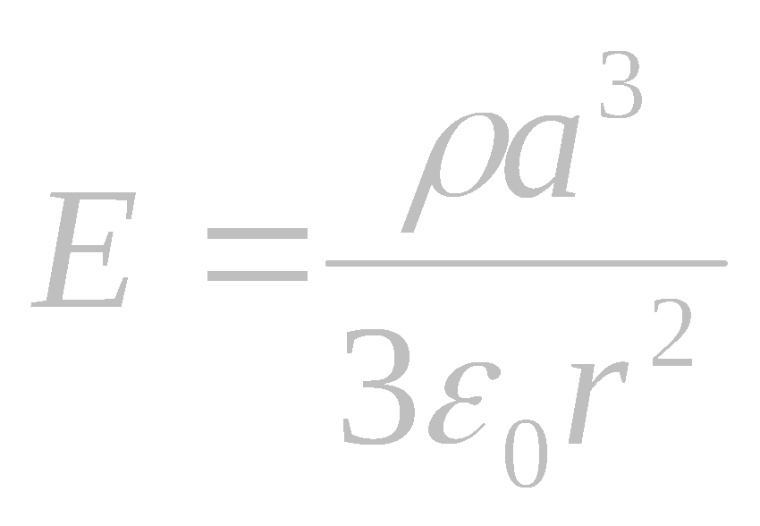
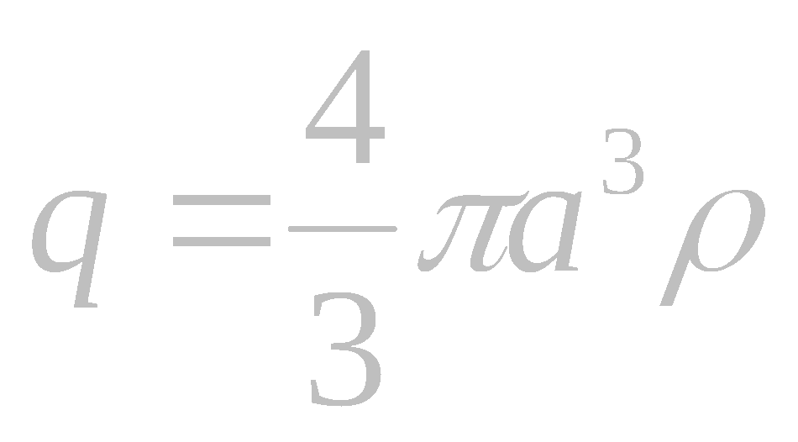
1. Uniform charged sphere
What is the magnitude of the electric field due to a solid sphere of radius a with uniform charge density ρ (C/m³)?
r
a
ρ
Outside sphere: (r>a)
  We have spherical symmetry centered on the center of the sphere of charge
  Therefore, choose Gaussian surface = hollow sphere of radius r
⇒
Gauss’
Law
same as point charge!

Slide 25

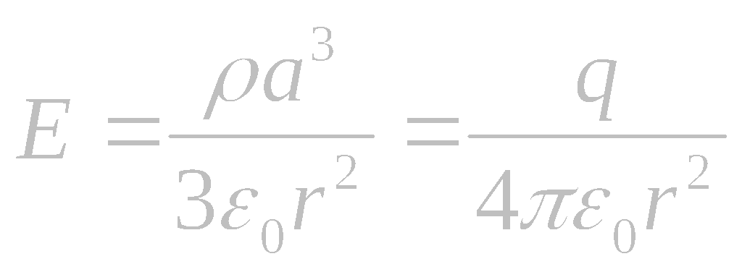

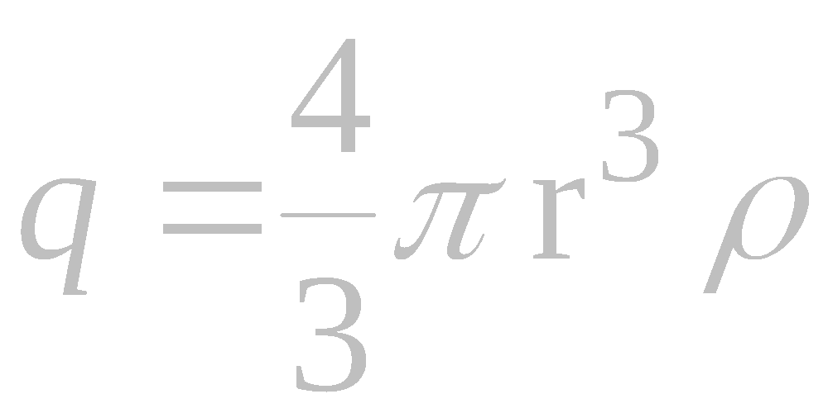
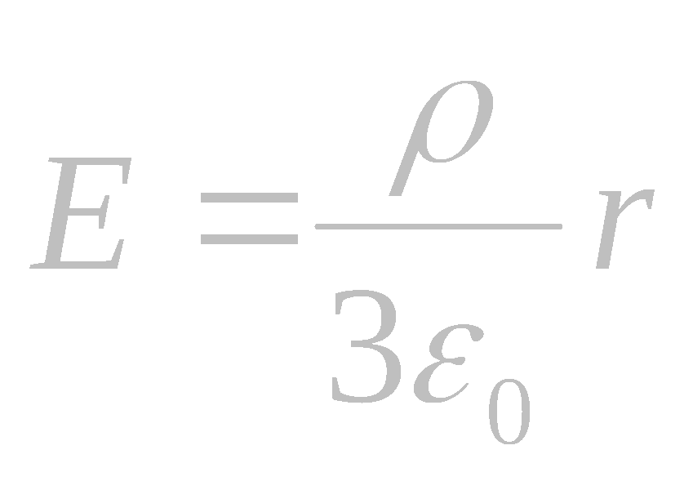
Uniform charged sphere
r
Outside sphere: (r > a)
Inside sphere: (r < a)
  We still have spherical symmetry centered on the center of the sphere of charge.
  Therefore, choose Gaussian surface = sphere of radius r
a
ρ
Gauss’
Law
But,
E
Thus:
a
r

Slide 26
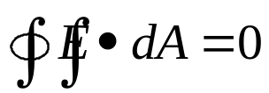
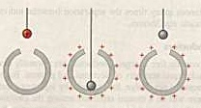
2. Gauss’ Law and Conductors
We know that E=0 inside a conductor (otherwise the charges would move).
But since → .
Charges on a conductor only reside on the surface(s)!
+
+
+
+
+
+
+
+
Conducting
sphere

Slide 27
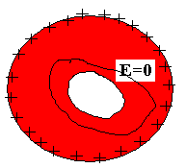
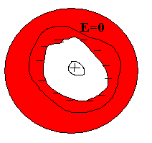
A charged isolated conductor
(带电的孤立导体)
An isolated conductor with a cavity.
Charge in cavity
The distribution of excess charge is not changed

Slide 28



The outer electric field for a charged conductor

Slide 29





3. Infinite Line of Charge
Symmetry ⇒ E-field must be ⊥ to line and can only depend on distance from line
Therefore, CHOOSE Gaussian surface to be a cylinder of radius r and length h aligned with the x-axis.
y
E_{r}
E_{r}
+ + + + + + + +
+ + +
+ + + +
+ + + + + +
+ + + + +
+ + +
x
h
Apply Gauss’ Law:
On the ends,
On the barrel,
AND
⇒
NOTE: we have obtained here the same result as we did last lecture using
Coulomb’s Law. The symmetry makes today’s derivation easier.

Slide 30






Chapter 27, ACT 2
A line charge λ (C/m) is placed along the axis of an uncharged conducting cylinder of inner radius r_{i} = a, and outer radius r_{o} = b as shown.
  What is the value of the charge density σ_{o} (C/m²) on the outer surface of the cylinder?
σ₀=?
b
a
λ
(a)
(b)
(c)
View end on:
Draw Gaussian tube which surrounds only the outer edge
σ_{o}
b

Slide 31

Preflight 4:
5) Given an infinite sheet of charge as shown in the figure. You need to use Gauss' Law to calculate the electric field near the sheet of charge. Which of the following Gaussian surfaces are best suited for this purpose?
Note: you may choose more than one answer
a) a cylinder with its axis along the plane
b) a cylinder with its axis perpendicular to the plane
c) a cube
d) a sphere

Slide 32




4. Infinite sheet of charge
Symmetry:
direction of E = x-axis
+σ
Therefore, CHOOSE Gaussian surface to be a cylinder whose axis is aligned with the x-axis.
A
x
Apply Gauss' Law:
E
E
On the barrel,
On the ends,
The charge enclosed = σ A
Therefore, Gauss’ Law ⇒
Conclusion: An infinite plane sheet of charge creates a CONSTANT electric field .

Slide 33



Two Infinite Sheets
(into the screen)
Field outside must be zero. Two ways to see:
  Superposition
  Gaussian surface encloses
  zero charge
+
-
σ
σ
E=0
E=0
+
-
+
-
+
-
+
-
A
+
-
Field inside is NOT zero:
  Superposition
  Gaussian surface encloses
  non-zero charge
+
-
+
-
+
-
-
+
A
-
+
-
+
-
0
E

Slide 34

Sheets of Charge
σ₁
σ_{L}
σ_{R}
A
B
C
D
Uncharged Conductor
Hints:
Assume σ is positive. If it’s negative, the answer will still work.
Assume to the right.
Use superposition, but keep signs straight
Think about which way a test charge would move.

Slide 35



Gauss’ Law: Help for the Problems
How to do practically all of the homework problems
Gauss’ Law is ALWAYS VALID!
What Can You Do With This?
  If you have (a) spherical, (b) cylindrical, or (c) planar symmetry AND:
    If you know the charge, you can calculate the electric field
    If you know the field (usually because E=0 inside conductor), you can calculate the charge.
Spherical Symmetry: Gaussian surface = Sphere of radius r
Cylindrical symmetry: Gaussian surface = cylinder of radius r
Planar Symmetry: Gaussian surface = Cylinder of area A

Slide 36

Summary
Gauss’ Law: Electric field flux through a closed surface is proportional to the net charge enclosed
Gauss’ Law is exact and always true….
Gauss’ Law makes solving for E-field easy when the symmetry is sufficient
  spherical, cylindrical, planar
Gauss’ Law proves that electric fields vanish in conductor
  extra charges reside on surface

Slide 37
Example 1: spheres
A solid conducting sphere is concentric with a thin conducting shell, as shown
The inner sphere carries a charge Q₁, and the spherical shell carries a charge Q₂, such that Q₂ = -3Q₁.
  How is the charge distributed on the sphere?
  How is the charge distributed on the spherical shell?
  What is the electric field at r < R₁?
  Between R₁ and R₂? At r > R₂?
  What happens when you connect the two spheres with a wire? (What are the charges?)
Q₂
Q₁
R₁
A
R₂
B
C
D

Slide 38

A
  How is the charge distributed on the sphere?
* The electric field inside a conductor is zero.
(A) By Gauss’s Law, there can be no net charge inside the conductor, and the charge must reside on the outside surface of the sphere
+
+
+
+
+
+
+
+

Slide 39
B
  How is the charge distributed on the spherical shell?
* The electric field inside the conducting shell is zero.
(B) There can be no net charge inside the conductor, therefore the inner surface of the shell must carry a net charge of -Q₁, and the outer surface must carry the charge +Q₁ + Q₂, so that the net charge on the shell equals Q₂.
The charges are distributed uniformly over the inner and outer surfaces of the shell, hence
and

Slide 40


C
  What is the Electric Field at r < R₁?
  Between R₁ and R₂? At r > R₂?
* The electric field inside a conductor is zero.
(C) r < R₁:
Inside the conducting sphere
(C) Between R₁ and R₂ : R₁ < r < R₂
Charge enclosed = Q₁
(C) r > R₂
Charge enclosed = Q₁ + Q₂

Slide 41
D
  What happens when you connect the two spheres with a wire? (What are the charges?)
-
-
-
-
After electrostatic equilibrium is reached, there is no charge on the inner sphere, and none on the inner surface of the shell. The charge Q₁ + Q₂ on the outer surface remains.
-
-
-
-
-
-
-
-
-
-
-
-
-
-
-
-
-
-
Also, for r < R₂
and for r > R₂

Slide 42
Example 2: Cylinders
An infinite line of charge passes directly through the middle of a hollow, charged, CONDUCTING infinite cylindrical shell of radius R. We will focus on a segment of the cylindrical shell of length h. The line charge has a linear charge density λ, and the cylindrical shell has a net surface charge density of σ_{total}.
σ_{total}
R
λ
σ_{inner}
σ_{outer}
h

Slide 43
σ_{outer}
R
λ
σ_{inner}
σ_{total}
h
A
  How is the charge distributed on the cylindrical shell?
    What is σ_{inner}?
    What is σ_{outer}?
  What is the electric field at r<R?
  What is the electric field for r>R?
B
C

Slide 44
A1
What is σ_{inner}?
σ_{outer}
R
λ
σ_{inner}
σ_{total}
h
The electric field inside the cylindrical shell is zero. Hence, if we choose as our Gaussian surface a cylinder, which lies inside the cylindrical shell, we know that the net charge enclosed is zero. Therefore, there will be a surface charge density on the inside wall of the cylinder to balance out the charge along the line.
The total charge on the enclosed portion (of length h) of the line charge is:
Total line charge enclosed = λ h
Therefore, the charge on the inner surface of the conducting cylindrical shell is
Q_{inner} = -λ h
The total charge is evenly distributed along the inside surface of the cylinder. Therefore, the inner surface charge density σ_{inner} is just Q_{inner} divided by total area of the cylinder: σ_{inner} = -λ h / 2π Rh = -λ / 2π R
Notice that the result is independent of h.

Slide 45
A2
  What is σ_{outer}?
σ_{outer}
R
λ
σ_{inner}
σ_{total}
h
  We know that the net charge density on the cylinder is σ_{total}. The charge densities on the inner and outer surfaces of the cylindrical shell have to add up to σ_{total}. Therefore,
  σ_{outer} =σ_{total} – σ_{inner} = σ_{total} +λ /(2π R).

Slide 46


B
  What is the Electric Field at r<R?
h
Gaussian surface
r
λ
R
h
Whenever we are dealing with electric fields created by symmetric charged surfaces, we must always first chose an appropriate Gaussian surface. In this case, for r <R, the surface surrounding the line charge is actually a cylinder of radius r.
Using Gauss’ Law, the following equation determines the E-field:
2πrhE_{r} = q_{enclosed} / ε_{ο}
q_{enclosed} is the charge on the enclosed line charge, which is λh, and (2πrh) is the area of the barrel of the Gaussian surface.
The result is:

Slide 47

C
What is the Electric field for r>R?
Gaussian surface
λ
R
σ_{total}
r
h
  As usual, we must first chose a Gaussian surface as indicated above. We also need to know the net charge enclosed in our Gaussian surface. The net charge is a sum of the following:
    Net charge enclosed on the line: λh
    Net charge enclosed within Gaussian surface, residing on the cylindrical shell: Q= 2πRh σ_{total}
  Therefore, net charge enclosed is Q + λh
  The surface area of the barrel of the Gaussian surface is 2πrh
  Now we can use Gauss’ Law: 2πrh E = (Q + λh) / ε_{o}
    You have all you need to find the Electric field now.
Solve for E_{r} to find

Slide 48


27-7 Experimental Tests of Gauss’Law and Coulomb’s Law
Gauss’ Law
Coulomb’s Law
See Page 625, Table 27-1

Slide 49
Homework
P₆₂₉ (Exercises): 7, 27,
P₆₃₁(Problems): 3, 6, 14

